Slide 1
DUNGEONS
&
PYTHONS
ADVENTURE GAME
INTERACTIVE

Slide 2
PRESENTACIÓN
01
02
03
IDEA
TECHNICAL PART
IMPROVEMENTS
What I have based on to develop the interactive adventure. Explanation of what the game is about
Development of the use of Python in this exercise.
This mini-quest has served as the main exercise to apply what has been learned in the introduction to Python
Things that can be improved for the future, both in functionality and in implementing more advanced Python usage

Slide 3
01
IDEA

Slide 4
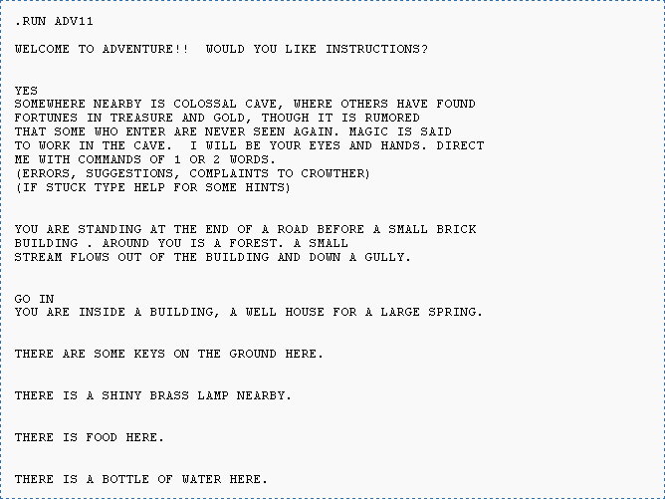
¿Why
DUNGEONS & PYTHONS?
Based on Colossal Cave Adventure (Willie Crowther, 1976) the first RPG for the computer
This project is developed as an update of the Conversational Adventure genre, a type of videogame very famous in the 80s
Dungeos&Pythons allows the player to choose his personalized character: name, race and profession. Depending on the decisions he chooses during the game, the developed narrative will change to be different for each run.

Slide 5
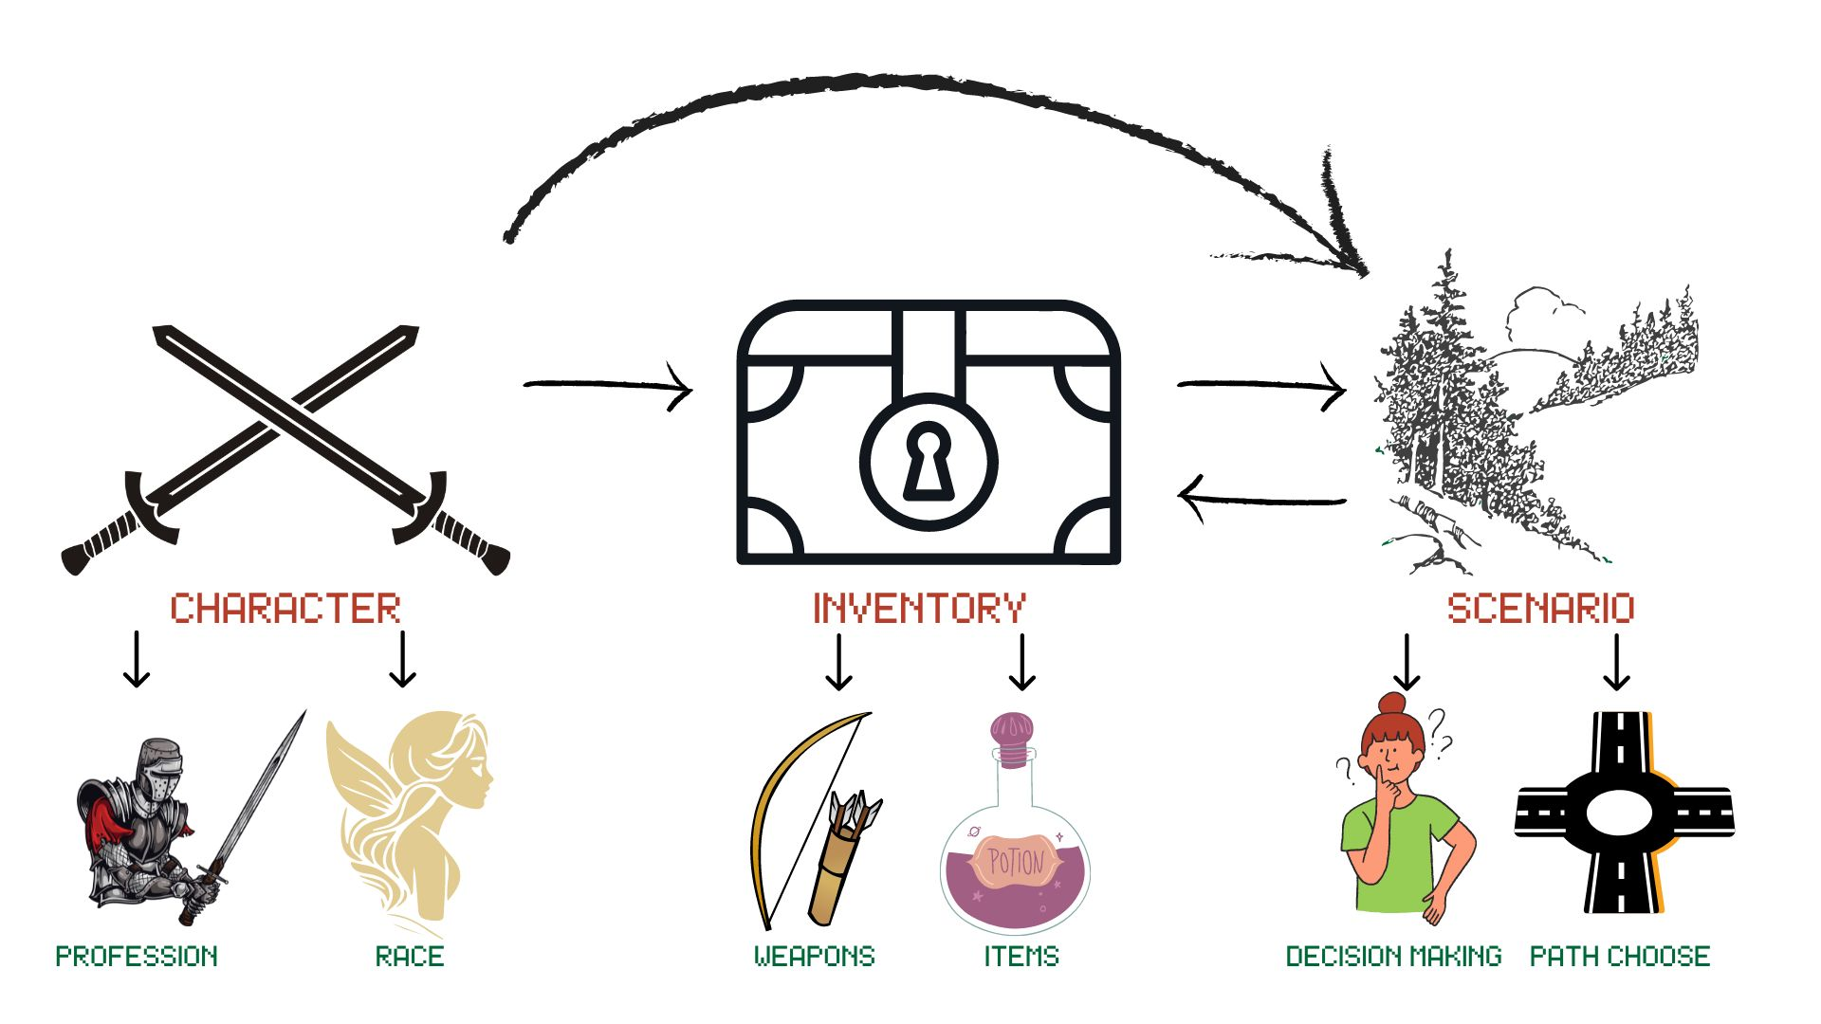
ADVENTURE SCHEME

Slide 6
02
TECHNICAL
PART

Slide 7
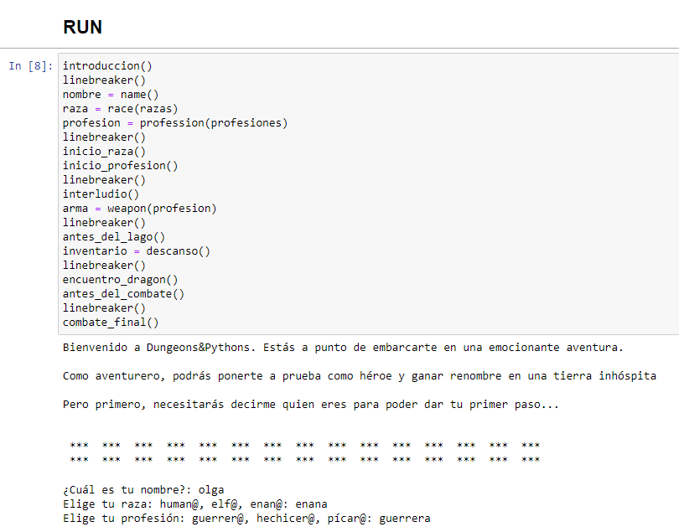
¿How D&P uses Python?
Use of different data structures such as lists and dictionaries. Use of built-in methods
Use of flow control: conditionals and loops.
Use of function definition to speed up the code and help future modification.
Implementation of Error Handling, to avoid code breakage

Slide 8
03
IMPROVEMENTS

Slide 9
What improvements will D&P have in the future?
Better exploration: return to previous locations
Better interaction: use items into scenarios
More character features
More choices to do and interact

Slide 10
¡GRACIAS!
github.com/TonioDominguez

